Slide 1




Topic 3
PROJECT MANAGEMENT AND SCHEDULING
SYSTEMS ANALYSIS AND DESIGN

Slide 2



CONTENT
SEGI UNIVERSITY
01
Understand project management fundamentals
02
System Development Methodologies
03
Develop project schedules
04
Allocate project resources

Slide 3
Project Management Body of Knowledge (PMBOK)
Developed by The Project Management Institute (PMI)
9 knowledge areas: foundation information for every project manager
Scope management
control functions included in system
control scope of work done by team
Time management
Build detailed schedule of all project tasks
Monitor progress of project against milestones
Cost management
Calculate initial cost/benefit analysis
Monitor expenses

Slide 4
Project Management Body of Knowledge (PMBOK) – cont.
Quality management
Establish quality plan and control activities for each project phase
Human resource management
Recruit and hire project team members
Train, motivate, team build
Communications management
Identify stakeholders and their communications
Establish team communications

Slide 5
Project Management Body of Knowledge (PMBOK) – cont.
Risk management
Identify and review risks for failure
Develop plans to reduce these risks
Procurement management
Develop requests for proposals (RFPs)‏
Evaluate bids, write contracts, monitor performance
Integration management
Coordinating all aspects of a project to ensure that its many elements work together effectively.
Focuses on making trade-offs, balancing competing objectives, and ensuring that the project delivers value that aligns with the organization’s goals.‏

Slide 6
Reasons for Project Failure
Category | Reason
People | Lack of user involvement
 | Weak executive support
 | Poor communication among stakeholders
Process | Poor requirements gathering & analysis
 | Inadequate project management
 | Scope creep (uncontrolled changes)
Resources | Insufficient budget, staff, or technology
 | Unrealistic timeframes & schedules
Technology | Technical challenges & complexity
 | Inadequate testing & quality assurance

Slide 7
ROLE OF PROJECT MANAGER
Project management – organizing and directing people to achieve a planned result within budget and on schedule
Project manager – a person has primary responsibility for the functioning of the team
Success or failure of project depends on skills of the project manager
Beginning of project – plan and organize
During project – monitor and control
Responsibilities are both internal and external

Slide 8
PM Internal Responsibilities
Identify project tasks and build a Work Breakdown Structure (WBS)
Define the milestones (i.e., key events in a project which can be identified by a specific pieces of documentation or a specific status review meeting) and deliverables to monitor progress.
Develop the project schedule
Assign team members to tasks
Coordinate activities of team members
Assess project risks
Monitor and control project deliverables and milestones
Verify the quality of project deliverables

Slide 9
PM External Responsibilities
Report the project’s status and progress
Establish good working relationships with those who identify the needed system requirements
People who will use the system
Work directly with the client (project’s sponsor) and other stakeholders
Identify resource needs and obtain resources

Slide 10
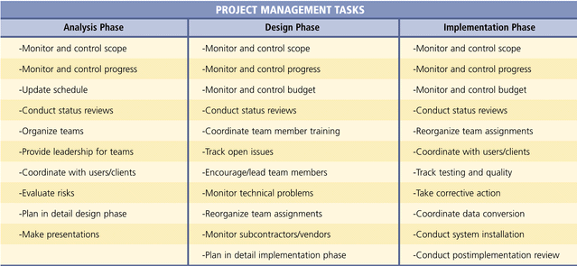
Project Management Tasks in SDLC

Slide 11
Project Execution Management
Following the project schedule
Assigning and coordinating the work of project team
Communicating with all project stakeholders

Slide 12
Project Control
Determining progress and taking corrective actions when necessary
Assessing whether requests for scope changes are necessary
Maintaining an outstanding issues list
Resolving problems

Slide 13
Project Closeout
To smooth project shutdown
Releasing team members for other assignments
Finalizing the budget
Reviewing or auditing the results of the projects

Slide 14
What’s A Systems Development Methodology?
A methodology is a formalized approach to implementing the SDLC (i.e., it is a list of steps and deliverables). .
There are many different systems development methodologies, and they vary in terms of the progression that is followed through the phases of the SDLC.

Slide 15
Why Use A Methodology?
Ensures that a consistent reproducible approach is applied to all projects
Reduces the risks associated with shortcuts and mistakes
Produces complete and consistent documentation from one project to the next
As development teams and staff change over time, the result of prior work can be easily retrieved, understood and modified as required

Slide 16
Traditional Methods: Waterfall Model
Waterfall Model – Follows a linear and sequential approach. Each phase of the project must be completed before the next begins, with little to no overlap between stages.
Two important variants of waterfall development:
V-Model – Extension of Waterfall that focus on testing, validation & verification.
Parallel Development - Evolved to address the lengthy time frame of waterfall development

Slide 17
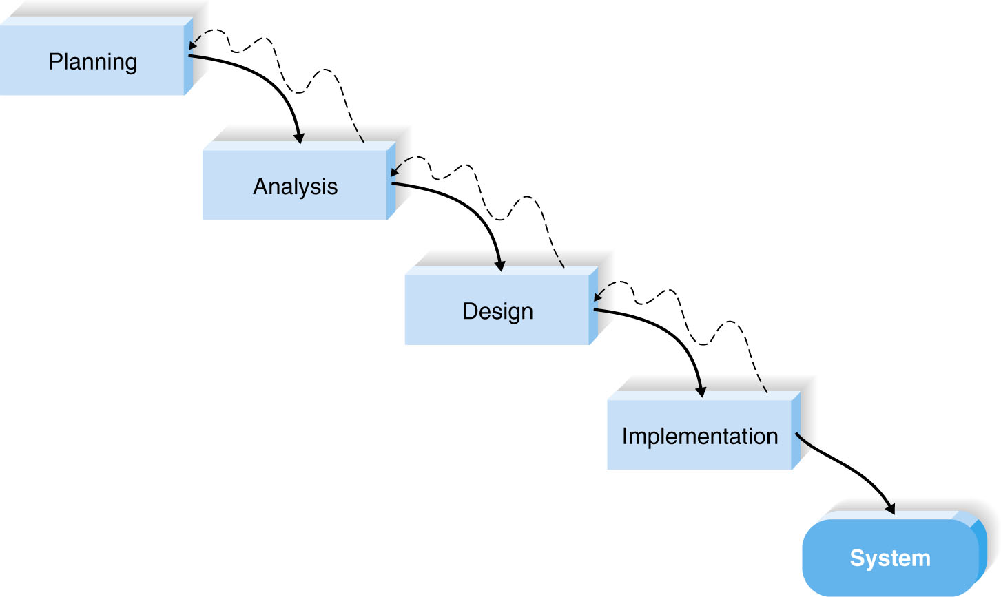
Waterfall Model
Notes:
Once the work produced in one phase is approved, the phase ends and the next phase begins. As the project progresses from phase to phase, it moves forward in the same manner as a waterfall. While it is possible to go backward through the phases (e.g., from design back to analysis), it is quite difﬁcult.
Waterfall development methodologies have the advantages of identifying requirements long before programming begins and limiting changes to the requirements as the project proceeds. The key disadvantages are that the design must be completely speciﬁed before programming begins, a long time elapses between the completion of the system proposal in the analysis phase and the delivery of system, and testing is treated almost as an afterthought in the implementation phase. In addition, the deliverables are often a poor communication mechanism, so important requirements may be overlooked in the volumes of documentation. If the project team misses an important requirement, expensive post-implementation programming may be needed. Users may forget the original purpose of the system, since so much time has elapsed between the original idea and actual implementation. Also, in today’s dynamic business environment, a system that met the existing environmental conditions during the analysis phase may need considerable rework to match the environment when it is implemented. This rework requires going back to the initial phase and making needed changes through each of the subsequent phases in turn.

Slide 18
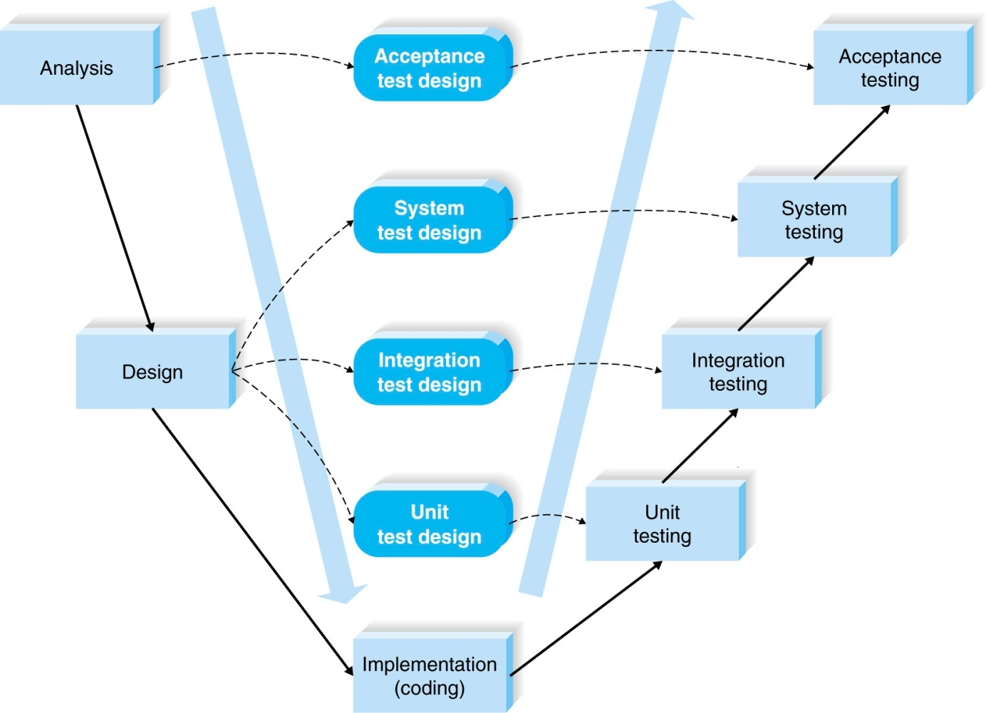
V-model
Notes:
the development process proceeds down the left-hand slope of the V, deﬁning requirements and designing system components. At the base of the V, the code is written. On the upward-sloping right side of the model, testing of components, integration testing, and, ﬁnally, acceptance testing are performed. A key concept of this model is that as requirements are speciﬁed and components designed, testing for those elements is also deﬁned. In this manner, each level of testing is clearly linked to a part of the analysis or design phase, helping to ensure high quality and relevant testing and maximize test effectiveness.
The V-model is simple and straightforward and improves the overall quality of systems through its emphasis on early development of test plans. Testing focus and expertise is involved in the project earlier rather than later; plus, the testers gain knowledge of the project early. It still suffers from the rigidity of the waterfall development process, however, and is not always appropriate for the dynamic nature of the business environment.

Slide 19
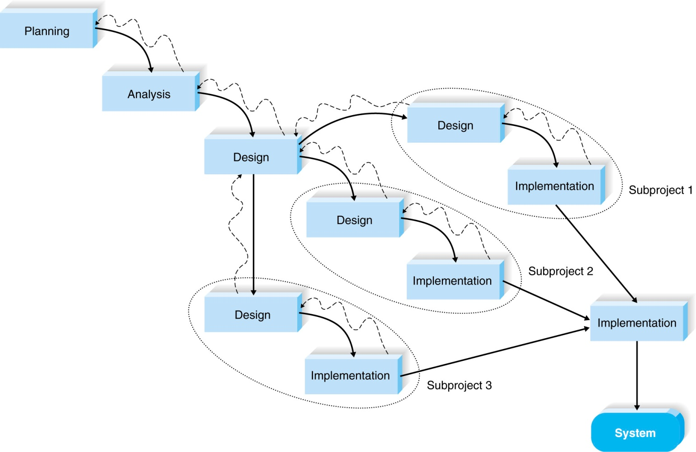
Parallel Development
Notes:
instead of doing the design and implementation in sequence, a general design for the whole system is performed. Then the project is divided into a series of subprojects that can be designed and implemented in parallel. Once all subprojects are complete, there is a ﬁnal integration of the separate pieces, and the system is delivered. Parallel development reduces the time required to deliver a system, so changes in the business environment are less likely to produce the need for rework. The approach still suffers from problems caused by voluminous deliverables. It also adds a new problem: If the subprojects are not completely independent, design decisions in one subproject may affect another, and at the project end, integrating the subprojects may be quite challenging.

Slide 20
Agile versus Waterfall-Based Methodologies
Agile development practices were created in part because of dissatisfaction with the sequential, inflexible structure of waterfall-based approaches.
https://www.youtube.com/watch?v=5RocT_OdQcA

Slide 21
Modern Methods: Agile Methodology
Agile is an iterative, flexible approach to software development that emphasizes collaboration, customer feedback, and rapid delivery.
It breaks work into small, manageable units called iterations or sprints.
Instead of following a rigid plan, Agile teams adapt continuously based on feedback and changing requirements.

Slide 22
Agile Methods
Attempt to develop a system incrementally, by building a series of prototypes and constantly adjusting them to user requirements
Emphasises continuous feedback from user and each incremental step is affected by what was learned in the prior steps
Advantage: allow developers to be much more flexible and responsive
Disadvantages: weak documentation, blurred lines of accountability, too little
emphasis on the larger business picture

Slide 23
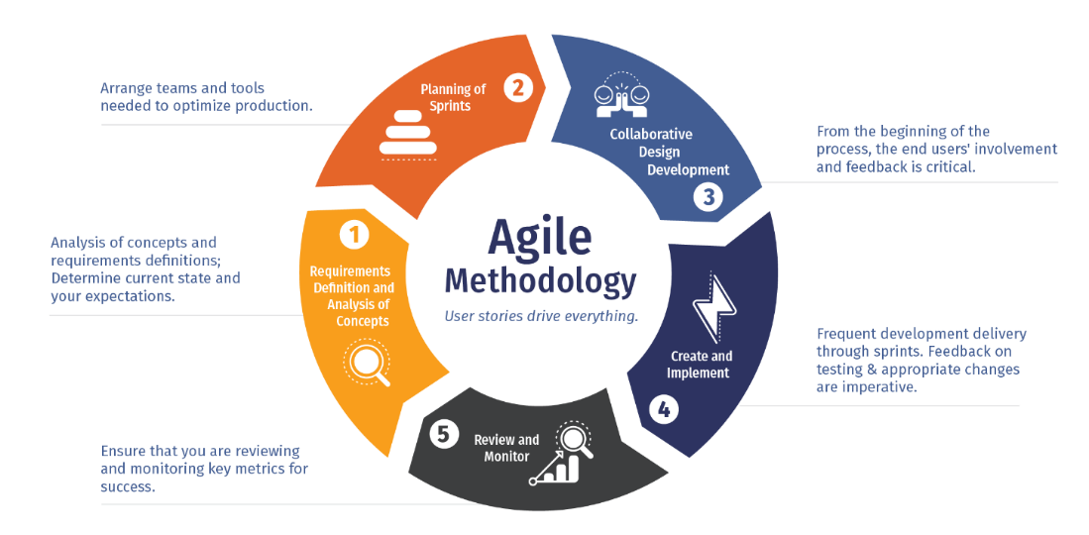
Agile Methodology

Slide 24
Agile Methods
Scrum – An iterative framework that focuses on Sprint and teamwork with clear roles (Product Owner, Scrum Master).
Kanban – Visual workflow, continuous improvement.
Extreme Programming (XP) – Emphasizes on technical practices and customer involvement. High code quality, frequent releases.
Introduction to Agile Development: Scrum, Kanban, and XP

Slide 25
Scrum
Iterative & Time-Boxed: Work is divided into fixed-length iterations called Sprints (typically 1-4 weeks).
Roles: Specific roles:
Product Owner (A team member who is responsible for identifying product features and attributes. The Product Owner reviews work done and helps to test the product)
Scrum Master (a team coach who guides the team in the effective use of Scrum)
Development Team (A small self-organizing team of five to eight people who are responsible for developing the product)
Events: Includes events like Daily Scrum, Sprint Reviews, and Sprint Retrospectives for team coordination and improvement.
Focus: Primarily on structured iterative progress and effective team collaboration to solve complex problems.
https://www.theserverside.com/video/Scrum-methodology-explained

Slide 26
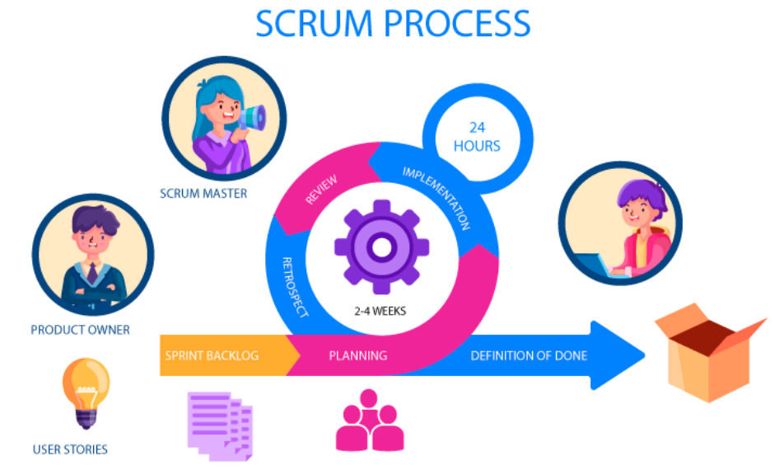

Slide 27
Kanban
Flow-Based: Focuses on continuous workflow and delivering value as it becomes ready.
Visual Management: Uses a Kanban board with cards to visualize work, often limiting the amount of work in progress (WIP) at any stage.
No Fixed Iterations: It's a pull system where team members pull work as they have the capacity, rather than work being "pushed" onto them.
Flexibility: Emphasizes optimizing the workflow rather than following a strict set of events or roles.

Slide 28
Extreme Programming (XP)
Technical Excellence: Focuses on high software quality and technical practices.
Practices: Mandates specific technical practices like test-driven development (TDD), pair programming, and continuous integration.
Frequent Releases: Encourages very short iterations and rapid delivery to ensure alignment with customer needs.
Customer Collaboration: Features high customer involvement to gather continuous feedback and ensure the product meets requirements.

Slide 29
RAD & Prototyping
Joint Application Development (JAD) – Structured workshops to gather accurate requirements.
Rapid Application Development (RAD) – Rapid development with user involvement and reusable components.
Prototyping (Throwaway) – Quick models to clarify needs.
Prototyping (System/Evolutionary) – Improved prototypes evolve into final system.

Slide 30
Rapid Application Development (RAD)
RAD is a collection of methodologies that emerged in response to the weaknesses of waterfall development and its variations.
RAD incorporates special techniques and computer tools to speed up the analysis, design, and implementation phases in order to get some portion of the system developed quickly and into the hands of the users for evaluation and feedback.

Slide 31
Rapid Application Development (RAD) (cont.)
CASE (computer-aided software engineering) tools, JAD (joint application development) sessions, fourth-generation/visual programming languages (e.g., Visual Basic.NET), and code generators may all play a role in RAD.
While RAD can improve the speed and quality of systems development, it may also introduce a problem in managing user expectations. As systems are developed more quickly and users gain a better understanding of information technology, user expectations may dramatically increase and system requirements may expand during the project.

Slide 32
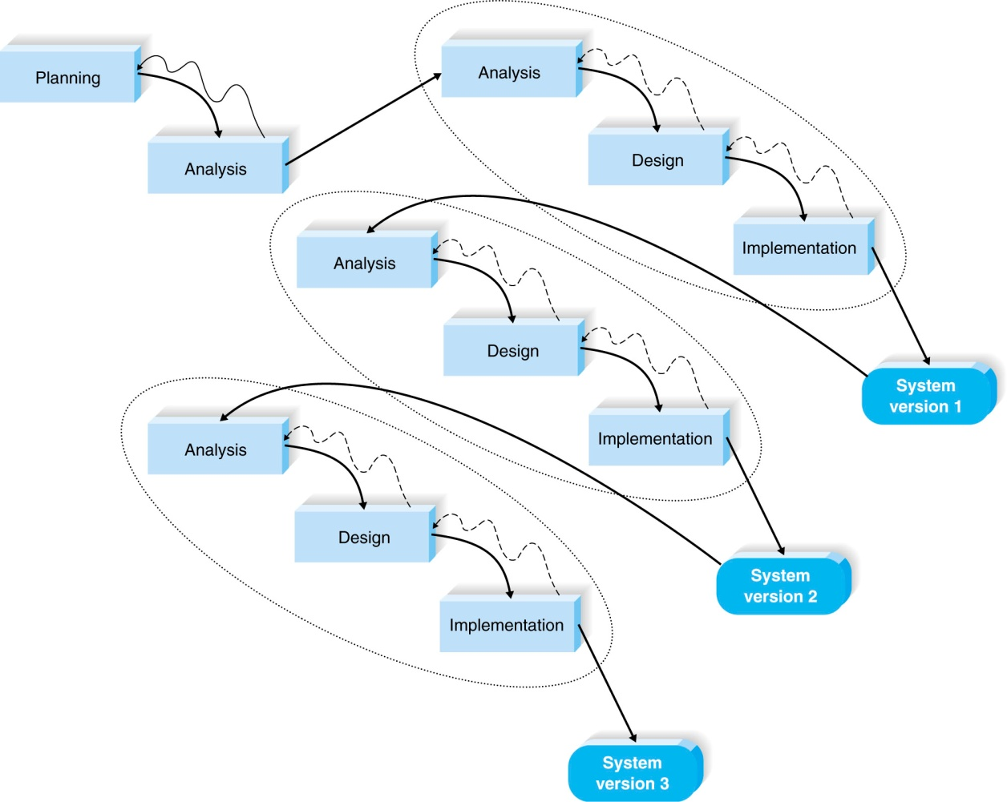
Rapid Application Development: Iterative Development
breaks the overall project into a series of versions that are developed sequentially.
Notes:
Iterative development breaks the overall project into a series of versions that are developed sequentially. The most important and fundamental requirements are bundled into the ﬁrst version of the system. This version is developed quickly by a mini-waterfall process, and once implemented, the users can provide valuable feedback to be incorporated into the next version of the system. (See Figure 2-5.) Iterative development gets a preliminary version of the system to the users quickly so that business value is provided. Since users are working with the system, important additional requirements may be identiﬁed and incorporated into subsequent versions. The chief disadvantage of iterative development is that users begin to work with a system that is intentionally incomplete. Users must accept that only the most critical requirements of the system will be available in the early versions and must be patient with the repeated introduction of new system versions

Slide 33
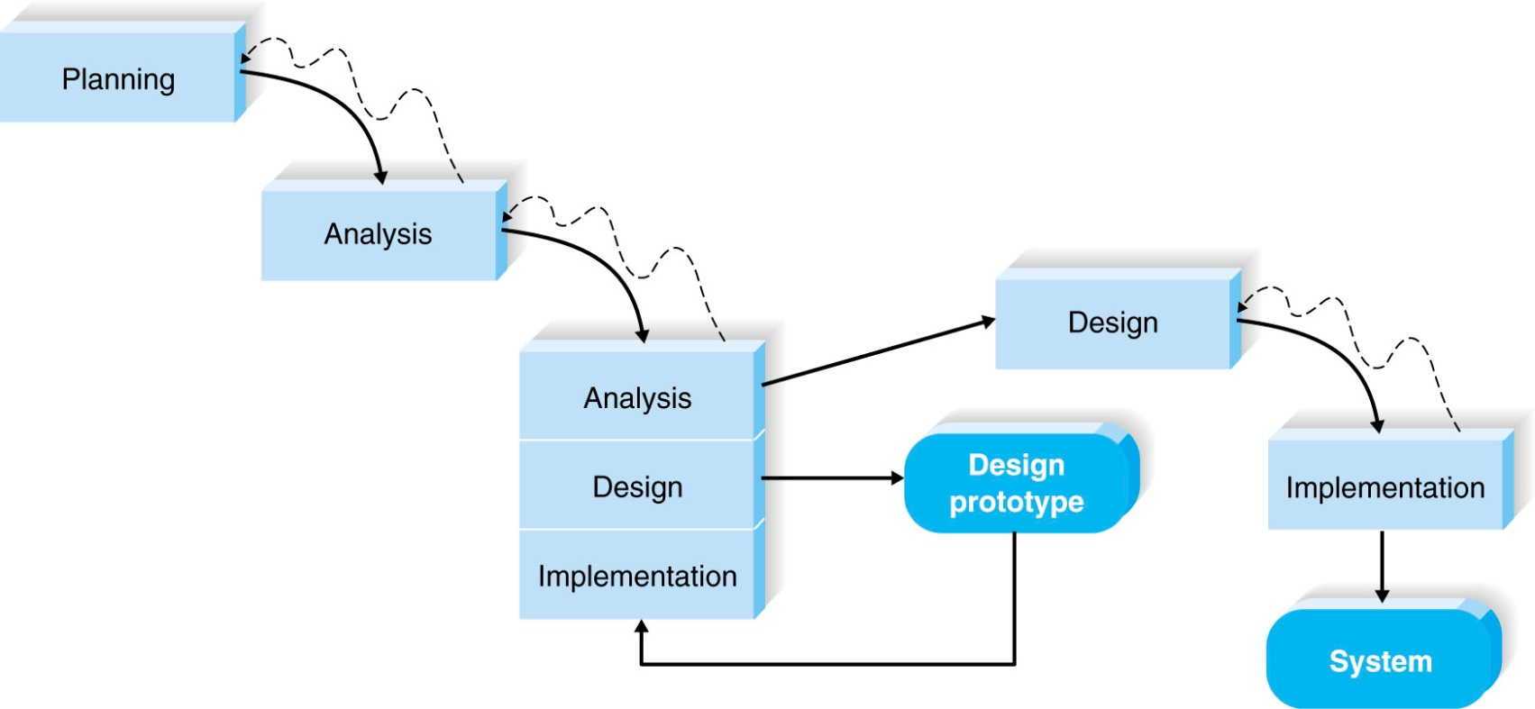
Rapid Application Development: Throwaway Prototyping
the development of prototypes to explore design alternatives rather than as the actual new system
Notes:
Throwaway prototyping6 includes the development of prototypes, but uses the prototypes primarily to explore design alternatives rather than as the actual new system (as in system prototyping). As shown in Figure 2-7, throwaway prototyping has a fairly thorough analysis phase that is used to gather requirements and to develop ideas for the system concept. Many of the features suggested by the users may not be well understood, however, and there may be challenging technical issues to be solved. Each of these issues is examined by analyzing, designing, and building a design prototype. A design prototype is not intended to be a working system. It contains only enough detail to enable users to understand the issues under consideration. For example, suppose that users are not completely clear on how an order entry system should work. The analyst team might build a series of HTML pages to be viewed on a Web browser to help the users visualize such a system. In this case, a series of mock-up screens appear to be a system, but they really do nothing. Or, suppose that the project team needs to develop a sophisticated graphics program in Java. The team could write a portion of the program with artiﬁcial data to ensure that they could create a full-blown program successfully. A system that is developed by this type of methodology probably requires several design prototypes during the analysis and design phases. Each of the prototypes is used to minimize the risk associated with the system by conﬁrming that important issues are understood before the real system is built. Once the issues are resolved, the project moves into design and implementation. At this point, the design prototypes are thrown away, which is an important difference between this approach and system prototyping, in which the prototypes evolve into the ﬁnal system. Throwaway prototyping balances the beneﬁts of well-thought-out analysis and design phases with the advantages of using prototypes to reﬁne key issues before a system is built. It may take longer to deliver the ﬁnal system compared with system prototyping (because the prototypes do not become the ﬁnal system), but the approach usually produces more stable and reliable systems.

Slide 34
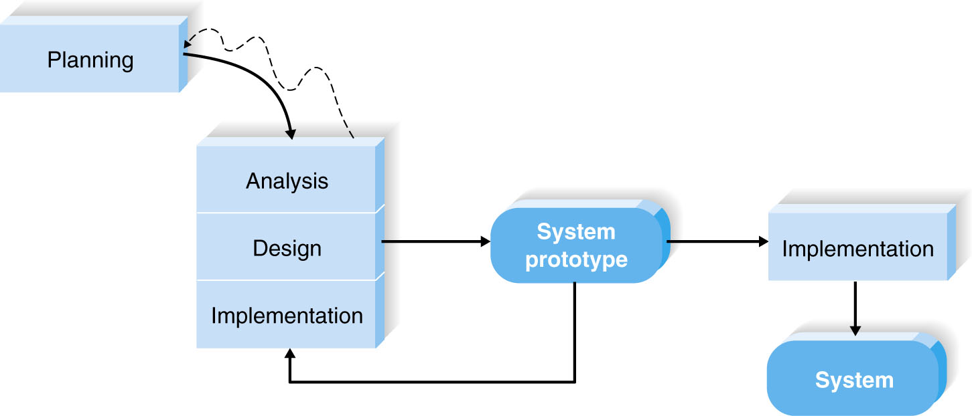
Rapid Application Development: System Prototyping
performs the analysis, design, and implementation phases concurrently in order to quickly develop a simpliﬁed version of the proposed system and give it to the users for evaluation and feedback.
Notes:
System prototyping performs the analysis, design, and implementation phases concurrently in order to quickly develop a simpliﬁed version of the proposed system and give it to the users for evaluation and feedback. (See Figure 2-6). The system prototype is a “quick and dirty” version of the system and provides minimal features. Following reaction and comments from the users, the developers reanalyze, redesign, and reimplement a second prototype that corrects deﬁciencies and adds more features. This cycle continues until the analysts, users, and sponsor agree that the prototype provides enough functionality to be installed and used in the organization. System prototyping very quickly provides a system for users to evaluate and reassures users that progress is being made. The approach is very useful when users have difﬁculty expressing requirements for the system. A disadvantage, however, is the lack of careful, methodical analysis prior to making design and implementation decisions. System prototypes may have some fundamental design limitations that are a direct result of an inadequate understanding of the system’s true requirements early in the project.

Slide 35
Modern DevOps Approach
DevOps – Combines development & operations to streamline and automate the software delivery process.
Continuous integration (CI) & delivery (CD).
Automation reduces errors, faster deployment.
Best for large-scale, frequent release projects.

Slide 36
Method | Advantages | Disadvantages | Best Use Cases
Waterfall | - Simple & structured - Easy to manage with clear phases | - Inflexible, hard to adapt to changes - Late testing (errors found late) | Projects with well-defined, stable requirements
Agile | - Flexible, adapts to changes - Continuous feedback - Fast delivery | - Requires strong collaboration - Less documentation | Dynamic environments, startups, web/mobile apps
Scrum | - Clear roles & responsibilities - Frequent delivery (sprints) | - Needs experienced team - Hard for long-term forecasting | Small-to-medium projects with changing requirements
Kanban | - Simple visual workflow - Continuous improvement | - No fixed roles - Risk of scope creep | Support/maintenance projects, continuous delivery
Extreme Programming (XP) | - High code quality - Frequent releases | - Requires disciplined team - Can be costly | Projects needing high reliability & frequent updates

Slide 37
Method | Advantages | Disadvantages | Best Use Cases
JAD (Joint Application Development) | - Improves requirement accuracy - Strong user involvement | - Time-consuming workshops - Needs user commitment | When requirements are ambiguous or conflicting
RAD (Rapid Application Development) | - Fast development - Heavy user involvement | - Needs skilled team & tools - Not suitable for large, complex systems | Short-deadline projects with active user input
Prototyping (Throwaway) | - Helps clarify requirements quickly - Users see early model | - Prototype discarded (wasted effort) - Users may think prototype = final system | When requirements are unclear
Prototyping (Evolutionary) | - Gradual improvement into final system - High user involvement | - Risk of poor design evolving - Can drag on too long | Complex projects where requirements evolve
DevOps | - Continuous integration & delivery - Faster deployment - Automation reduces errors | - Needs cultural change - High tool investment | Large-scale projects with frequent releases

Slide 38
Best Fit
Stable requirements → Waterfall / V-Model
Unclear or changing requirements → Agile / Prototyping / RAD
Continuous delivery & automation → DevOps

Slide 39
Selecting the Appropriate Development Methodology (cont.)
Important factors to consider in selecting the development methodology
- Clarity of User Requirements
- Familiarity with Technology
- System Complexity
- System Reliability
- Short Time Schedules
- Schedule Visibility

Slide 40
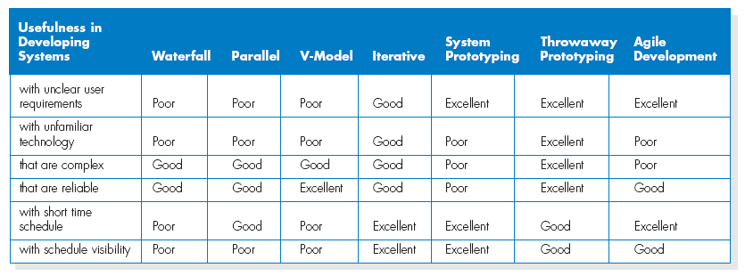
Selecting the Appropriate Development Methodology

Slide 41
Estimating the Project Time Frame
Project Manager will have to develop a preliminary estimate of the amount of time the project will take.
Estimation is the process of assigning projected values for time and effort.

Slide 42
CREATING THE PROJECT PLAN
Once the project is selected by the approval committee, it is time to carefully plan the project.
The project manager will follow a set of project management guidelines, sometimes referred to as the project management life cycle, as he or she organizes, guides, and directs the project from inception to completion.

Slide 43
Creating The Project Plan
Project management phases consist of:
- initiation
- planning
- execution
- control, and
- closure.

Slide 44
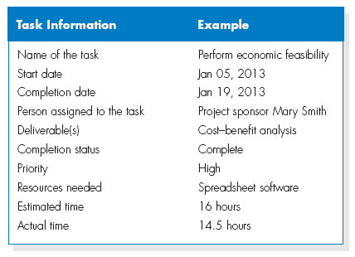
Developing the Work Plan
Identify Tasks

Slide 45
Work Breakdown Structure (WBS)
A work breakdown structure (WBS) is a hierarchy of tasks, activities and phases for the project.
It is used as a foundation for developing the project schedule, identifying milestones in the schedule and for managing the costs
Each task has an associated duration (sometimes three different values: expected, pessimistic and optimistic) and number of resources required)
How to identify tasks:
Top-down: identify major activities first, then internal tasks
Bottom-up: list all the tasks and organize them
Analogy: from similar projects

Slide 46
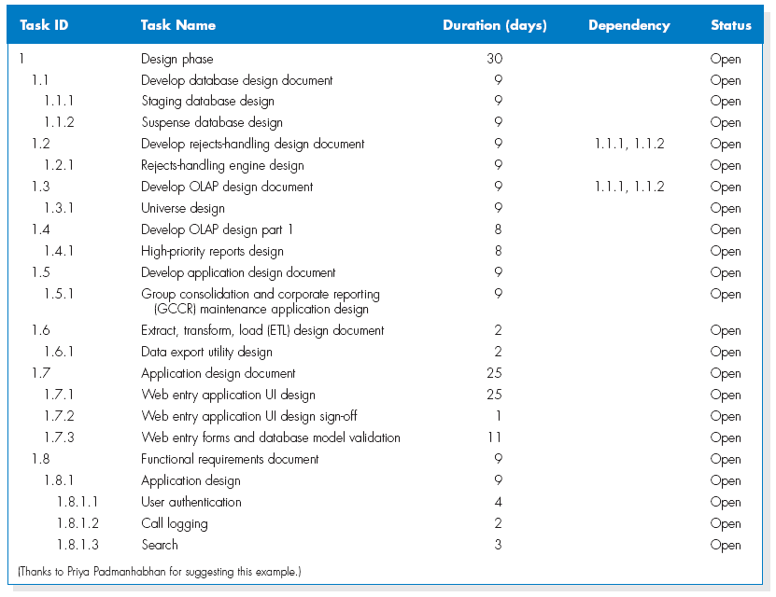
Developing the Work Plan (cont.)
Work Breakdown Structure

Slide 47
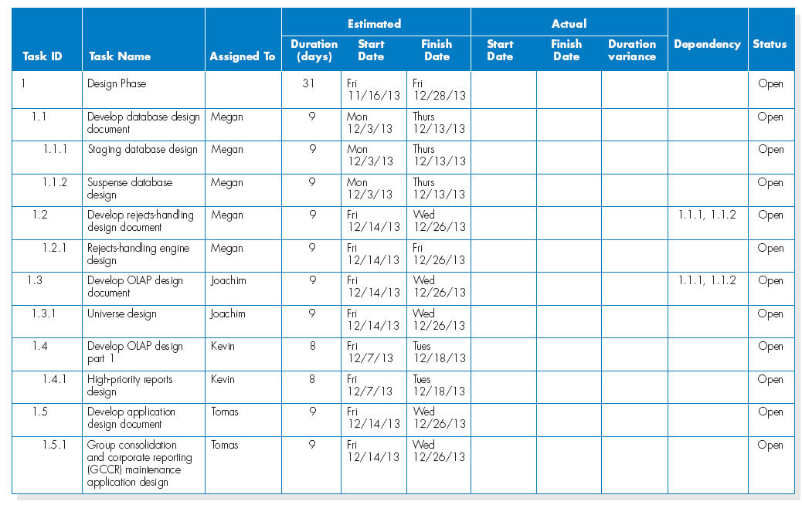
Developing the Work Plan (cont.)
The project work plan

Slide 48
Staffing The Project
Staffing Plan
- Staffing levels will change over a project’s lifetime
- Adding staff may add more overhead than additional labor
- Using teams of 8-10 reporting in a hierarchical structure can reduce complexity

Slide 49
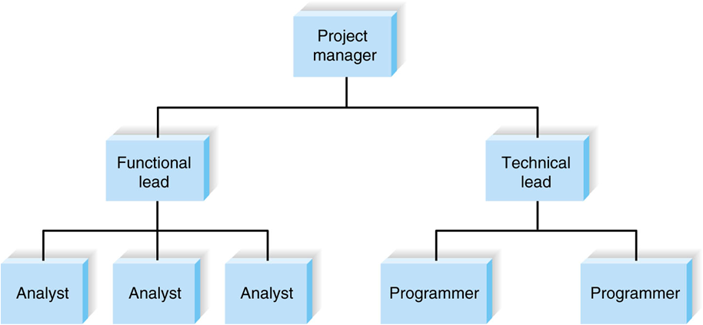
Staffing The Project (cont.)
Reporting structure

Slide 50
Staffing The Project (cont.)
The staffing plan describes the kinds of people working on the project
The project charter describes the project’s objectives and rules
A functional lead manages a group of analysts
A technical lead oversees progress of programmers and technical staff members

Slide 51
MANAGING AND CONTROLLING THE PROJECT
The science (or art) of project management is in making trade-offs among three important concepts:
- the size of the system,
- the time to complete the project,
- the cost of the project.

Slide 52
Project Schedule: Gantt chart
A Gantt Chart is a visual project management tool that displays tasks along a timeline. It helps IT teams plan, schedule, and track progress by showing task durations, dependencies, and milestones.
It shows information for each task as horizontal bar chart where the vertical tick marks are calendar days and weeks:
A good tool for monitoring the progress of the project
Tasks represented by horizontal bars
Vertical marks are calendar days and weeks
Shows calendar information in a way that is easy to track
Bars may be colored or darkened to show completed tasks

Slide 53
Project Schedule: Gantt chart

Slide 54
Managing And Controlling The Project – Gantt Chart (cont.)
Gantt charts can present an overview of the project’s status, but they do not provide enough detailed information, which is necessary when managing a complex project.
Most project managers find that PERT/CPM charts, are better tools for managing large projects.

Slide 55
SUMMARY
Systems Development Methods include: structured, OO, Agile.
A project requires staffing and coordinating project activities.

